Slide 1
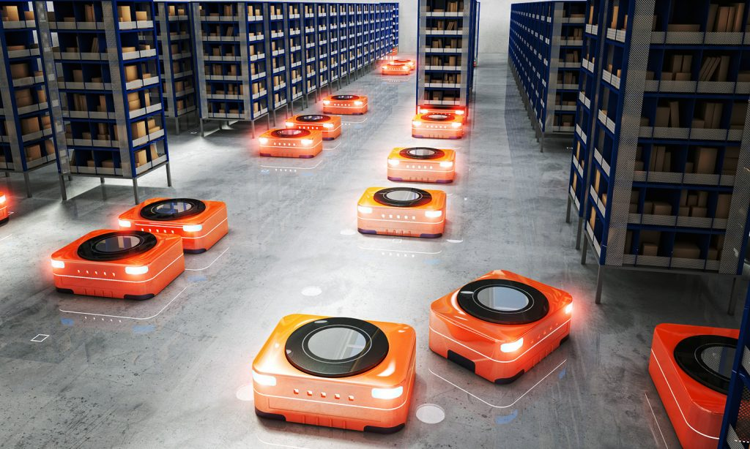




3SAT to MAPF reduction
By: Hanna Keller
Based on the paper:
“Multi-Agent Path Finding with Payload Transfers and the Package-Exchange Robot-Routing Problem” by Hang Ma, Craig Tovey, Guny Sharon, T. K. Satish Kumar and Sven Koenig

Slide 2

Package-Exchange Robot-Routing Problem (PERR) – formal definition
$G=(V,E)$ (undirected connected graph)
M packages $\left\{p_{1},p_{2},…,p_{M}\right\}$
$s_{i}$ - the source vertex of the package $p_{i}$
$d_{i}$ - the destination vertex of the package $p_{i}$

Slide 3

Package-Exchange Robot-Routing Problem (PERR) - definition
$l_{i}$(t) - the vertex of $p_{i}$ at time t = 0 ... ∞
Plan - assigns a function $l_{i}$ to each package $p_{i}$
Solution - a plan that satisfies the following conditions:
For all packages i, $l_{i}$(0) = $s_{i}$
For all packages i, there exists a time $T_{i}^{end}$ such that, for all times t = $T_{i}^{end}$ ... ∞, $l_{i}$(t) = $d_{i}$ ($T_{i}^{end}$ is the smallest such time)
For all packages i and all times t, (${l_{i}\text{(}\text{t}\text{)}\text{,}l}_{i}$(t+1)) ∈ E or $l_{i}$(t) = $l_{i}$(t+1)
For all pairs of different packages i and j and all times t, $l_{i}$(t) ≠ $l_{j}$(t)

Slide 4

Package-Exchange Robot-Routing Problem (PERR) - definition
Makespan - the time in which the last package reaches its destination, therefore the makespan of a solution is $\max_{i}$( $T_{i}^{end}$).
flowtime - the sum of the times when each package reaches its destination, so the flowtime of the solution is $\sum_{i}{T_{i}^{end}}$ .
Package exchange - two packages $p_{i}$ and $p_{j}$ can be exchanged in a single time step:
If they are at adjacent vertices.
Formally, $l_{i}\text{(}\text{t}\text{)}=l_{j}\text{(}\text{t}\text{+}\text{1}\text{)}$ and $l_{j}\text{(}\text{t}\text{)}=l_{i}\text{(}\text{t}\text{+}\text{1}\text{)}$ at the corresponding time t.

Slide 5

PERR is NP-hard to approximate within any factor less than $\frac{4}{3}$ for makespan minimization and NP-hard to solve for flowtime minimization

Slide 6
3-SAT problem: reminder
3SAT is the set of satisfiable boolean expressions that are expressed in 3CNF.
For an expression to be in 3CNF form, it must satisfy two constraints:
The expression is made up of ANDed together clauses, which themselves are made up of ORred together literals.
Each clause contains at most 3 literals: there can be any number of clauses ANDed together, but there can only be one, two or three literals in each clause.
The decision question asks if the expression is satisfiable.
Example: ($x_{1}$ ∨ $x_{2}$∨ $x_{3}$)∧($x_{4}$∨ ¬$x_{2}$)

Slide 7

≤3,=3-SAT problem
n boolean variables $X_{1}…X_{n}$.
m disjunctive clauses $C_{1}$ ... $C_{m}$.
Each variable appears in exactly three clauses.
Each variable is uncomplemented at least once.
Each variable is complemented at least once.
Each clause contains at most three literals.
The decision question asks whether the instance is satisfiable.
There is a simple randomized algorithm due to Schöning (1999) that runs in time ${(\frac{4}{3})}^{n}$ where n is the number of variables in the 3-SAT proposition, and succeeds with high probability to correctly decide 3-SAT.
Example: (${\text{¬}x}_{1}$ ∨ $x_{2}$∨ $x_{3}$)∧(¬$x_{2}$) ∧($x_{1}$∨ ¬$x_{3}$) ∧($x_{1}$∨ ¬$x_{2}$ ∨ $x_{3}$)

Slide 8

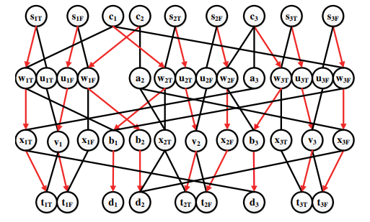
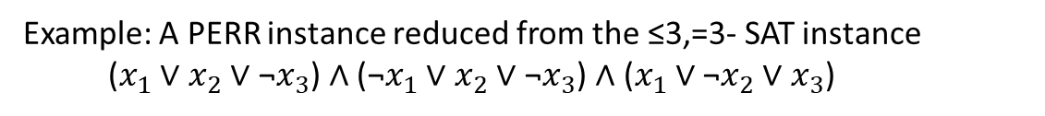
We will construct a PERR instance that has a solution with makespan=3 if and only if a given ≤3,=3-SAT instance is satisfiable
Example: A PERR instance reduced from the ≤3,=3- SAT instance ($x_{1}$ ∨ $x_{2}$∨ ${\text{¬}x}_{3}$) ∧ (${\text{¬}x}_{1}$ ∨ $x_{2}$∨ $\text{¬}x_{3}$) ∧ ($x_{1}$ ∨ ${\text{¬}x}_{2}$∨ $x_{3}$)

Slide 9


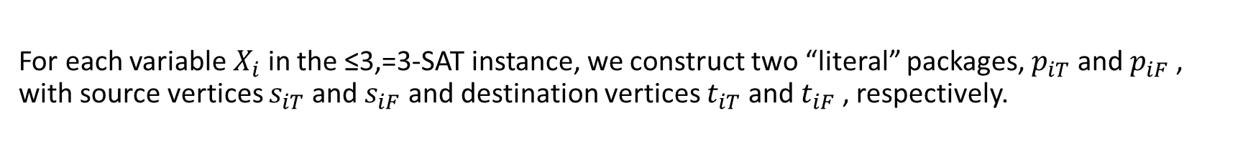










For each variable $X_{i}$ in the ≤3,=3-SAT instance, we construct two “literal” packages, $p_{iT}$ and $p_{iF}$ , with source vertices $s_{iT}$ and $s_{iF}$ and destination vertices $t_{iT}$ and $t_{iF}$ , respectively.
$$s_{1T}$$
$$s_{1F}$$
$$s_{2T}$$
$$s_{2F}$$
$$s_{3T}$$
$$s_{3F}$$
$$t_{1T}$$
$$t_{1F}$$
$$t_{2T}$$
$$t_{2F}$$
$$t_{3T}$$
$$t_{3F}$$
≤3,=3-SAT instance: ($x_{1}$ ∨ $x_{2}$∨ ${\text{¬}x}_{3}$) ∧ (${\text{¬}x}_{1}$ ∨ $x_{2}$∨ $\text{¬}x_{3}$) ∧ ($x_{1}$ ∨ ${\text{¬}x}_{2}$∨ $x_{3}$)

Slide 10

































For each literal package, we construct two paths to get to its destination vertex in three time steps: a “shared” path, and a “private” path.
Private path
$$s_{1T}$$
$$s_{1F}$$
$$s_{2T}$$
$$s_{2F}$$
$$s_{3T}$$
$$s_{3F}$$
Shared path
$$w_{1T}$$
$$u_{1T}$$
$$u_{1F}$$
$$w_{1F}$$
$$w_{2T}$$
$$u_{2T}$$
$$u_{2F}$$
$$w_{2F}$$
$$w_{3T}$$
$$u_{3T}$$
$$u_{3F}$$
$$w_{3F}$$
$$x_{1T}$$
$$v_{1}$$
$$x_{1F}$$
$$x_{2T}$$
$$v_{2}$$
$$x_{2F}$$
$$x_{3T}$$
$$v_{3}$$
$$x_{3F}$$
$$t_{1T}$$
$$t_{1F}$$
$$t_{2T}$$
$$t_{2F}$$
$$t_{3T}$$
$$t_{3F}$$
≤3,=3-SAT instance: ($x_{1}$ ∨ $x_{2}$∨ ${\text{¬}x}_{3}$) ∧ (${\text{¬}x}_{1}$ ∨ $x_{2}$∨ $\text{¬}x_{3}$) ∧ ($x_{1}$ ∨ ${\text{¬}x}_{2}$∨ $x_{3}$)

Slide 11



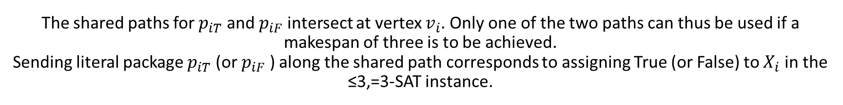
The shared paths for $p_{iT}$ and $p_{iF}$ intersect at vertex $v_{i}$. Only one of the two paths can thus be used if a makespan of three is to be achieved. Sending literal package $p_{iT}$ (or $p_{iF}$ ) along the shared path corresponds to assigning True (or False) to $X_{i}$ in the ≤3,=3-SAT instance.
Private path
$$s_{1T}$$
$$s_{1F}$$
$$s_{2T}$$
$$s_{2F}$$
$$s_{3T}$$
$$s_{3F}$$
Shared path
$$w_{1T}$$
$$u_{1T}$$
$$u_{1F}$$
$$w_{1F}$$
$$w_{2T}$$
$$u_{2T}$$
$$u_{2F}$$
$$w_{2F}$$
$$w_{3T}$$
$$u_{3T}$$
$$u_{3F}$$
$$w_{3F}$$
$$x_{1T}$$
$$v_{1}$$
$$x_{1F}$$
$$x_{2T}$$
$$v_{2}$$
$$x_{2F}$$
$$x_{3T}$$
$$v_{3}$$
$$x_{3F}$$
$$t_{1T}$$
$$t_{1F}$$
$$t_{2T}$$
$$t_{2F}$$
$$t_{3T}$$
$$t_{3F}$$
≤3,=3-SAT instance: ($x_{1}$ ∨ $x_{2}$∨ ${\text{¬}x}_{3}$) ∧ (${\text{¬}x}_{1}$ ∨ $x_{2}$∨ $\text{¬}x_{3}$) ∧ ($x_{1}$ ∨ ${\text{¬}x}_{2}$∨ $x_{3}$)

Slide 12





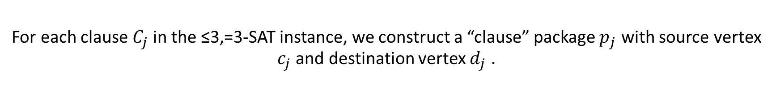

For each clause $C_{j}$ in the ≤3,=3-SAT instance, we construct a “clause” package $p_{j}$ with source vertex $c_{j}$ and destination vertex $d_{j}$ .
Private path
$$s_{1T}$$
$$s_{1F}$$
$$c_{1}$$
$$c_{2}$$
$$s_{2T}$$
$$s_{2F}$$
$$c_{3}$$
$$s_{3T}$$
$$s_{3F}$$
Shared path
$$w_{1T}$$
$$u_{1T}$$
$$u_{1F}$$
$$w_{1F}$$
$$w_{2T}$$
$$u_{2T}$$
$$u_{2F}$$
$$w_{2F}$$
$$w_{3T}$$
$$u_{3T}$$
$$u_{3F}$$
$$w_{3F}$$
$$x_{1T}$$
$$v_{1}$$
$$x_{1F}$$
$$x_{2T}$$
$$v_{2}$$
$$x_{2F}$$
$$x_{3T}$$
$$v_{3}$$
$$x_{3F}$$
$$t_{1T}$$
$$t_{1F}$$
$$d_{1}$$
$$d_{2}$$
$$t_{2T}$$
$$t_{2F}$$
$$d_{3}$$
$$t_{3T}$$
$$t_{3F}$$
≤3,=3-SAT instance: ($x_{1}$ ∨ $x_{2}$∨ ${\text{¬}x}_{3}$) ∧ (${\text{¬}x}_{1}$ ∨ $x_{2}$∨ $\text{¬}x_{3}$) ∧ ($x_{1}$ ∨ ${\text{¬}x}_{2}$∨ $x_{3}$)

Slide 13

























The ≤3,=3-SAT instance has multiple (but at most three) “clause” paths to get to its destination vertex in 3 time steps, which have a one-to-one correspondence to the literals in $c_{j}$.
Private path
$$s_{1T}$$
$$s_{1F}$$
$$c_{1}$$
$$c_{2}$$
$$s_{2T}$$
$$s_{2F}$$
$$c_{3}$$
$$s_{3T}$$
$$s_{3F}$$
Shared path
Clause path
$$w_{1T}$$
$$u_{1T}$$
$$u_{1F}$$
$$w_{1F}$$
$$w_{2T}$$
$$u_{2T}$$
$$u_{2F}$$
$$w_{2F}$$
$$w_{3T}$$
$$u_{3T}$$
$$u_{3F}$$
$$w_{3F}$$
$$x_{1T}$$
$$v_{1}$$
$$x_{1F}$$
$$b_{1}$$
$$x_{2T}$$
$$v_{2}$$
$$x_{2F}$$
$$x_{3T}$$
$$v_{3}$$
$$x_{3F}$$
$$t_{1T}$$
$$t_{1F}$$
$$d_{1}$$
$$d_{2}$$
$$t_{2T}$$
$$t_{2F}$$
$$d_{3}$$
$$t_{3T}$$
$$t_{3F}$$
≤3,=3-SAT instance: ($x_{1}$ ∨ $x_{2}$∨ ${\text{¬}x}_{3}$) ∧ (${\text{¬}x}_{1}$ ∨ $x_{2}$∨ $\text{¬}x_{3}$) ∧ ($x_{1}$ ∨ ${\text{¬}x}_{2}$∨ $x_{3}$)

Slide 14












Every literal $x_{i}$(or ${\text{¬}x}_{i}$) can appear in at most two clauses. If $c_{j}$ is the first clause that it appears in, then the clause path is < $c_{j}$ , $w_{iT}$ , $b_{j}$ , $d_{j}$ > (or < $c_{j}$ , $w_{iF}$ , $b_{j}$ , $d_{j}$ > ). If $c_{j}$ is the second clause that it appears in, a vertex $a_{j}$ is introduced and the clause path is instead < $c_{j}$ , $a_{j}$ , $x_{iT}$ , $d_{j}$ > (or < $c_{j}$ , $a_{j}$ , $x_{iF}$ , $d_{j}$ > ).
Private path
$$s_{1T}$$
$$s_{1F}$$
$$c_{1}$$
$$c_{2}$$
$$s_{2T}$$
$$s_{2F}$$
$$c_{3}$$
$$s_{3T}$$
$$s_{3F}$$
Shared path
Clause path
$$w_{1T}$$
$$u_{1T}$$
$$u_{1F}$$
$$w_{1F}$$
$$a_{2}$$
$$w_{2T}$$
$$u_{2T}$$
$$u_{2F}$$
$$w_{2F}$$
$$a_{3}$$
$$w_{3T}$$
$$u_{3T}$$
$$u_{3F}$$
$$w_{3F}$$
$$x_{1T}$$
$$v_{1}$$
$$x_{1F}$$
$$b_{1}$$
$$b_{2}$$
$$x_{2T}$$
$$v_{2}$$
$$x_{2F}$$
$$b_{3}$$
$$x_{3T}$$
$$v_{3}$$
$$x_{3F}$$
$$t_{1T}$$
$$t_{1F}$$
$$d_{1}$$
$$d_{2}$$
$$t_{2T}$$
$$t_{2F}$$
$$d_{3}$$
$$t_{3T}$$
$$t_{3F}$$
≤3,=3-SAT instance: ($x_{1}$ ∨ $x_{2}$∨ ${\text{¬}x}_{3}$) ∧ (${\text{¬}x}_{1}$ ∨ $x_{2}$∨ $\text{¬}x_{3}$) ∧ ($x_{1}$ ∨ ${\text{¬}x}_{2}$∨ $x_{3}$)

Slide 15












The clause path of each $c_{j}$ with respect to any literal in that clause and the private path of the literal intersect. Only one of the two paths can thus be used if a makespan of three is to be achieved.
Private path
$$s_{1T}$$
$$s_{1F}$$
$$c_{1}$$
$$c_{2}$$
$$s_{2T}$$
$$s_{2F}$$
$$c_{3}$$
$$s_{3T}$$
$$s_{3F}$$
Shared path
Clause path
$$w_{1T}$$
$$u_{1T}$$
$$u_{1F}$$
$$w_{1F}$$
$$a_{2}$$
$$w_{2T}$$
$$u_{2T}$$
$$u_{2F}$$
$$w_{2F}$$
$$a_{3}$$
$$w_{3T}$$
$$u_{3T}$$
$$u_{3F}$$
$$w_{3F}$$
$$x_{1T}$$
$$v_{1}$$
$$x_{1F}$$
$$b_{1}$$
$$b_{2}$$
$$x_{2T}$$
$$v_{2}$$
$$x_{2F}$$
$$b_{3}$$
$$x_{3T}$$
$$v_{3}$$
$$x_{3F}$$
$$t_{1T}$$
$$t_{1F}$$
$$d_{1}$$
$$d_{2}$$
$$t_{2T}$$
$$t_{2F}$$
$$d_{3}$$
$$t_{3T}$$
$$t_{3F}$$
≤3,=3-SAT instance: ($x_{1}$ ∨ $x_{2}$∨ ${\text{¬}x}_{3}$) ∧ (${\text{¬}x}_{1}$ ∨ $x_{2}$∨ $\text{¬}x_{3}$) ∧ ($x_{1}$ ∨ ${\text{¬}x}_{2}$∨ $x_{3}$)

Slide 16






Suppose that a satisfying assignment to the ≤3,=3-SAT instance exists. Then, a solution with makespan three is obtained by sending literal packages of true literals along their shared paths, the other literal packages along their private paths and clause packages along the clause paths corresponding to one of the true literals in those clauses.
${Solution: x}_{1}$ = True, $x_{2}$ = True, $x_{3}$ = False
Private path
$$c_{3}$$
$x_{1}$ = True
$$s_{2F}$$
$$c_{3}$$
$$s_{3T}$$
$$s_{1T}$$
$$s_{1F}$$
$$c_{1}$$
$$s_{2T}$$
$$s_{3F}$$
$$c_{1}$$
$$c_{2}$$
$x_{2}$ = True
$x_{3}$ = False
$$c_{2}$$
Shared path
Clause path
$$w_{1T}$$
$$u_{1T}$$
$$u_{1F}$$
$$w_{1F}$$
$$a_{2}$$
$$w_{2T}$$
$$u_{2T}$$
$$u_{2F}$$
$$w_{2F}$$
$$a_{3}$$
$$w_{3T}$$
$$u_{3T}$$
$$u_{3F}$$
$$w_{3F}$$
$$x_{1T}$$
$$v_{1}$$
$$x_{1F}$$
$$b_{1}$$
$$b_{2}$$
$$x_{2T}$$
$$v_{2}$$
$$x_{2F}$$
$$b_{3}$$
$$x_{3T}$$
$$v_{3}$$
$$x_{3F}$$
$$t_{1T}$$
$$t_{1F}$$
$$d_{1}$$
$$d_{2}$$
$$t_{2T}$$
$$t_{2F}$$
$$d_{3}$$
$$t_{3T}$$
$$t_{3F}$$
≤3,=3-SAT instance: ($x_{1}$ ∨ $x_{2}$∨ ${\text{¬}x}_{3}$) ∧ (${\text{¬}x}_{1}$ ∨ $x_{2}$∨ $\text{¬}x_{3}$) ∧ ($x_{1}$ ∨ ${\text{¬}x}_{2}$∨ $x_{3}$)

Slide 17


, suppose that a solution with makespan=3 exists. Then, each clause package traverses the clause path corresponding to one of the literals in that clause, and the corresponding literal package traverses its shared path.
Private path
$$s_{1T}$$
$$s_{1F}$$
$$c_{1}$$
$$c_{2}$$
$$s_{2T}$$
$$s_{2F}$$
$$c_{3}$$
$$s_{3T}$$
$$s_{3F}$$
Shared path
Clause path
$$w_{1T}$$
$$u_{1T}$$
$$u_{1F}$$
$$w_{1F}$$
$$a_{2}$$
$$w_{2T}$$
$$u_{2T}$$
$$u_{2F}$$
$$w_{2F}$$
$$a_{3}$$
$$w_{3T}$$
$$u_{3T}$$
$$u_{3F}$$
$$w_{3F}$$
$$x_{1T}$$
$$v_{1}$$
$$x_{1F}$$
$$b_{1}$$
$$b_{2}$$
$$x_{2T}$$
$$v_{2}$$
$$x_{2F}$$
$$b_{3}$$
$$x_{3T}$$
$$v_{3}$$
$$x_{3F}$$
$$t_{1T}$$
$$t_{1F}$$
$$d_{1}$$
$$d_{2}$$
$$t_{2T}$$
$$t_{2F}$$
$$d_{3}$$
$$t_{3T}$$
$$t_{3F}$$
≤3,=3-SAT instance: ($x_{1}$ ∨ $x_{2}$∨ ${\text{¬}x}_{3}$) ∧ (${\text{¬}x}_{1}$ ∨ $x_{2}$∨ $\text{¬}x_{3}$) ∧ ($x_{1}$ ∨ ${\text{¬}x}_{2}$∨ $x_{3}$)

Slide 18

Since the packages of a literal and its complement cannot both use their shared path if a makespan=3 is to be achieved, we can assign True to every literal whose package uses its shared path without assigning True to both the uncomplemented and complemented literals.
Private path
$$s_{1T}$$
$$s_{1F}$$
$$c_{1}$$
$$c_{2}$$
$$s_{2T}$$
$$s_{2F}$$
$$c_{3}$$
$$s_{3T}$$
$$s_{3F}$$
Shared path
Clause path
$$w_{1T}$$
$$u_{1T}$$
$$u_{1F}$$
$$w_{1F}$$
$$a_{2}$$
$$w_{2T}$$
$$u_{2T}$$
$$u_{2F}$$
$$w_{2F}$$
$$a_{3}$$
$$w_{3T}$$
$$u_{3T}$$
$$u_{3F}$$
$$w_{3F}$$
$$x_{1T}$$
$$v_{1}$$
$$x_{1F}$$
$$b_{1}$$
$$b_{2}$$
$$x_{2T}$$
$$v_{2}$$
$$x_{2F}$$
$$b_{3}$$
$$x_{3T}$$
$$v_{3}$$
$$x_{3F}$$
$$t_{1T}$$
$$t_{1F}$$
$$d_{1}$$
$$d_{2}$$
$$t_{2T}$$
$$t_{2F}$$
$$d_{3}$$
$$t_{3T}$$
$$t_{3F}$$
≤3,=3-SAT instance: ($x_{1}$ ∨ $x_{2}$∨ ${\text{¬}x}_{3}$) ∧ (${\text{¬}x}_{1}$ ∨ $x_{2}$∨ $\text{¬}x_{3}$) ∧ ($x_{1}$ ∨ ${\text{¬}x}_{2}$∨ $x_{3}$)

Slide 19
If the packages of both literals use their private paths, we can assign True to any one of the literals and False to the other one. A solution to the PERR instance with makespan three thus yields a satisfying assignment to the ≤3,=3-SAT instance!
Private path
$$s_{1T}$$
$$s_{1F}$$
$$c_{1}$$
$$c_{2}$$
$$s_{2T}$$
$$s_{2F}$$
$$c_{3}$$
$$s_{3T}$$
$$s_{3F}$$
Shared path
Clause path
$$w_{1T}$$
$$u_{1T}$$
$$u_{1F}$$
$$w_{1F}$$
$$a_{2}$$
$$w_{2T}$$
$$u_{2T}$$
$$u_{2F}$$
$$w_{2F}$$
$$a_{3}$$
$$w_{3T}$$
$$u_{3T}$$
$$u_{3F}$$
$$w_{3F}$$
$$x_{1T}$$
$$v_{1}$$
$$x_{1F}$$
$$b_{1}$$
$$b_{2}$$
$$x_{2T}$$
$$v_{2}$$
$$x_{2F}$$
$$b_{3}$$
$$x_{3T}$$
$$v_{3}$$
$$x_{3F}$$
$$t_{1T}$$
$$t_{1F}$$
$$d_{1}$$
$$d_{2}$$
$$t_{2T}$$
$$t_{2F}$$
$$d_{3}$$
$$t_{3T}$$
$$t_{3F}$$
≤3,=3-SAT instance: ($x_{1}$ ∨ $x_{2}$∨ ${\text{¬}x}_{3}$) ∧ (${\text{¬}x}_{1}$ ∨ $x_{2}$∨ $\text{¬}x_{3}$) ∧ ($x_{1}$ ∨ ${\text{¬}x}_{2}$∨ $x_{3}$)

Slide 20
Thanks!

